Slide 1



Newton’s 1st Law Notes
Forces cause changes in motion.

Slide 2
Causes of Motion
Aristotle (384-322 BC) believed that all objects had a “natural place” and that the tendency of an object was to reside in its “natural place.”
All objects were classified into categories of earth, water, air, or fire.
“Natural motion” occurred when an object sought to return to its “natural place” after being moved from it by some type of “violent motion.”
The natural state of an object was to be “at rest” in its “natural place.”
To keep an object moving would require a force.

Slide 3

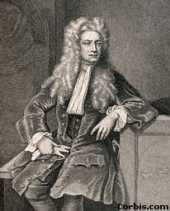
These views remained widely
supported until the 1500s
when Galileo Galilei (1564-1642)
popularized experimentation.
Isaac Newton (1642–1727)
proposed that the tendency of
an object was to maintain its
current state of motion.

Slide 4

Newton’s Law of Inertia
Newton’s first law states that every object continues in a state of rest, or of uniform speed in a straight line, unless acted on by a nonzero net force.
Newton’s first law, usually called the law of inertia, is a restatement of Galileo’s idea that a force is not needed to keep an object moving.

Slide 5
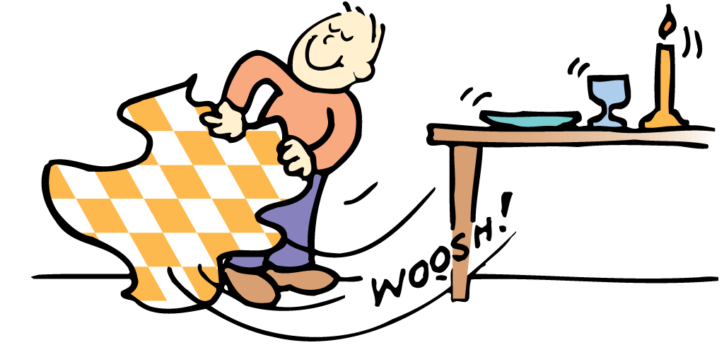
Newton’s Law of Inertia
Objects at Rest
Simply put, things tend to keep on doing what they’re already doing.
  Objects in a state of rest tend to remain at rest.
  Only a force will change that state.

Slide 6
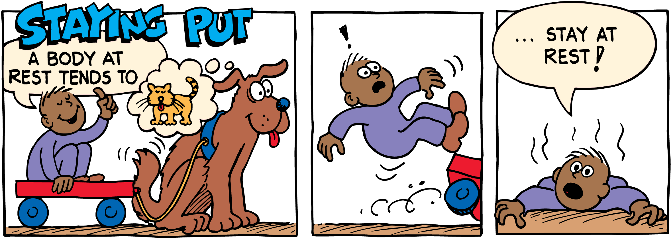
Newton’s Law of Inertia

Slide 7


Newton’s Law of Inertia
Objects in Motion
Now consider an object in motion.
  In the absence of forces, a moving object tends to move in a straight line indefinitely.
  Toss an object from a space station located in the vacuum of outer space, and the object will move forever due to inertia.

Slide 8
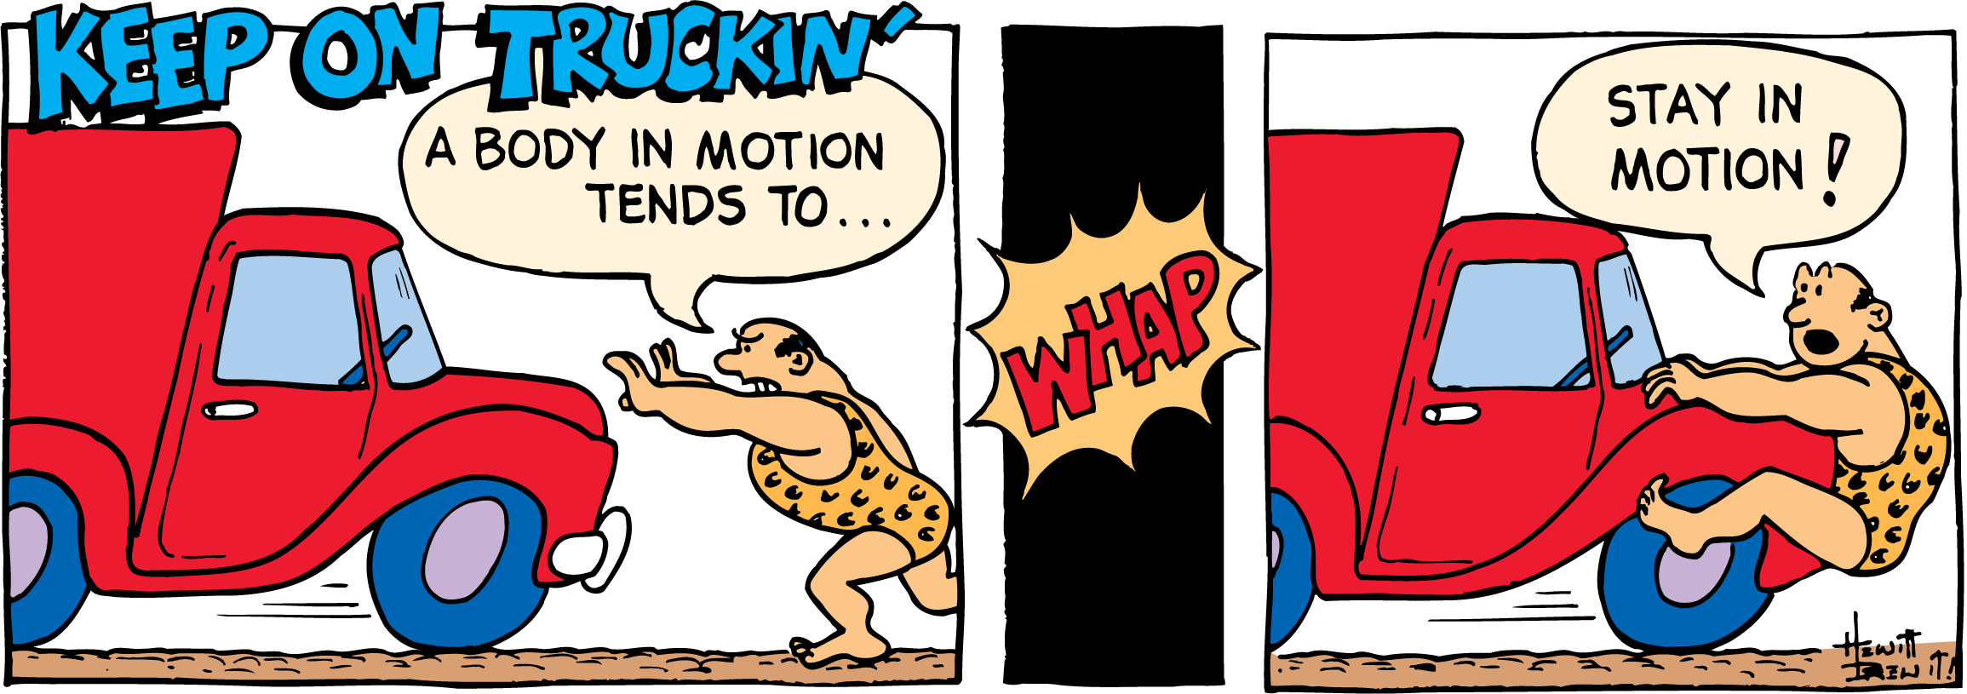
Newton’s Law of Inertia

Slide 9
Newton’s Law of Inertia Explained
The law of inertia provides a completely different way of viewing motion from the ancients.
  Objects continue to move by themselves.
  Forces are needed to overcome any friction that may be present and to set objects in motion initially.
  Once the object is moving in a force-free environment, it will move in a straight line indefinitely.

Slide 10
Mass—A Measure of Inertia
The more mass an object has, the
greater its inertia and the more force it takes to change its state of motion.
The amount of inertia an object has depends on its mass—which is roughly the amount of material present in the object.

Slide 11
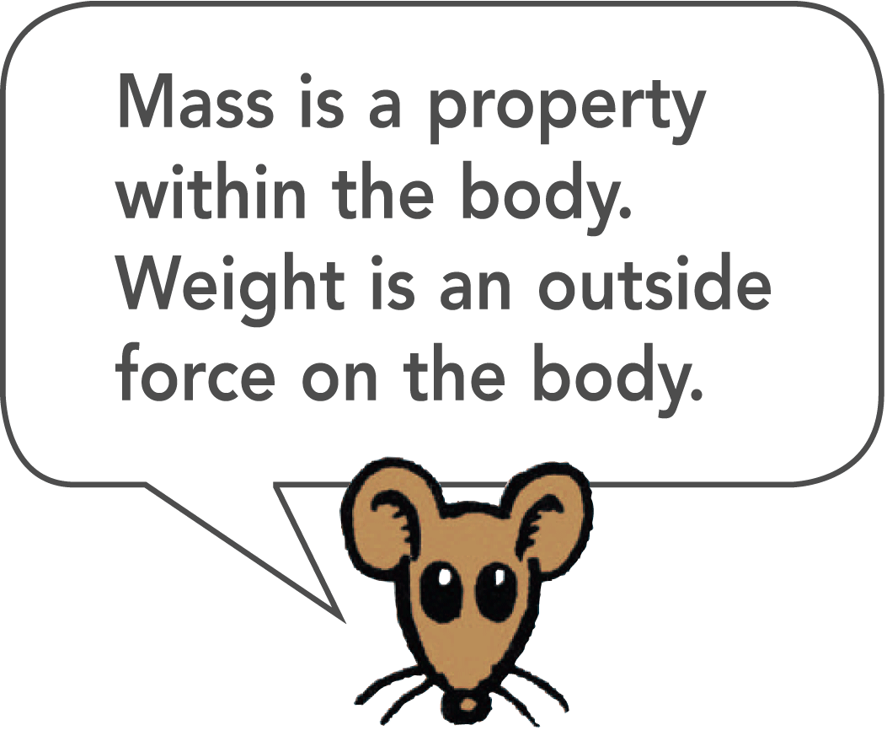
Mass Is Not Weight
Mass is often confused with weight.
  We often determine the amount of matter in an object by measuring its gravitational attraction to Earth. However, mass is more fundamental than weight.
  Mass is a measure of the amount of material in an object. Weight, on the other hand, is a measure of the gravitational force acting on the object.

Slide 12
One Kilogram Weighs 10 Newtons
It is common to describe the amount of matter in an object by its gravitational pull to Earth, that is, by its weight.
  In the United States, the traditional unit of weight is the pound. In most parts of the world, however, the measure of matter is commonly expressed in units of mass, the kilogram (kg).
  At Earth’s surface, 1 kilogram has a weight of 2.2 pounds.

Slide 13
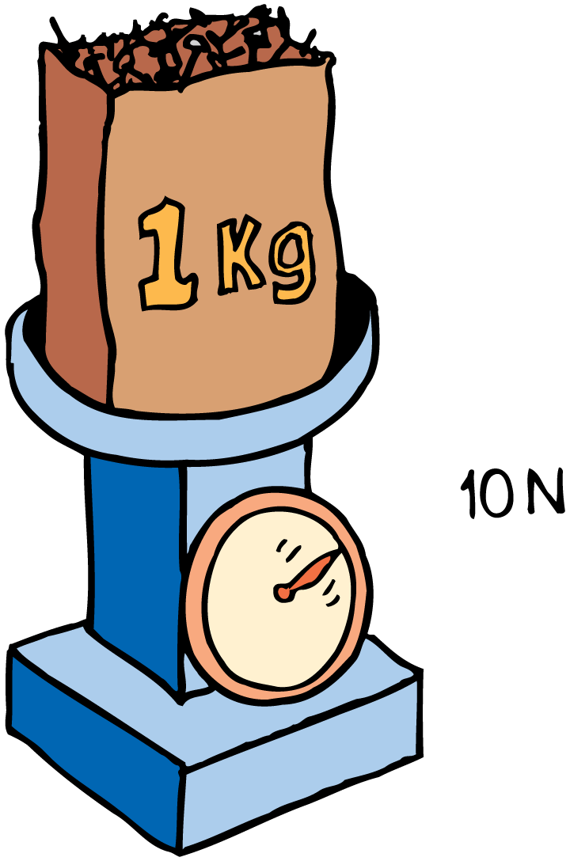
One Kilogram Weighs 10 Newtons
The SI unit of force is the newton. The SI symbol for the newton is N.
One newton is equal to slightly less than a quarter pound.
If you know the mass of something in kilograms and want its weight in newtons at Earth’s surface, multiply the number of kilograms by 10.

